Slide 1
Files in Python
Buffers

Slide 2
Why a buffer?
Computer equipment runs at different speeds, the hard drive and secondary storage in general is MUCH slower than RAM and the CPU, for example
This is a bottleneck where the faster pieces have to wait for the slower ones to deliver the action or service or data that is needed
Buffers help this bottleneck! They let the OS bring in a bigger chunk of data to RAM and hold it until the program asks for it = not so many trips to the hard drive

Slide 3
What’s a buffer?
A buffer is an area of RAM allocated by the OS to manage these bottlenecks
Every file you open in your program will have a buffer
Also buffers for keyboard, screen, network connections, modems, printers, etc.
You the programmer do not have to worry about this happening, it’s automatic!

Slide 4
Buffer for input file
When you read from a file, the buffer associated with the file is checked first – if there’s still data in the buffer, that’s what your program gets
If the buffer is exhausted, then the OS is told to get some more data from the file on the HD and put it in the buffer
This process continues until the program ends or until the file has no more data to read
Think of a pantry in a house – it’s a buffer between the people in the house and the supermarket

Slide 5
Buffer for output file
You write in your program to an output file
The data does NOT go directly, immediately to the hard drive, but to an output buffer
The OS monitors this buffer – when it is full, it is all written to the hard drive at one time
Think of a garbage can in a house – it is a buffer to hold trash until it can all be taken to the landfill at one time

Slide 6
Why do I care about buffers?
You can see most of the action on a buffer is automatic from the point of view of most programmers
BUT! if you forget to close your file when you are finished with it, the file can be left in an “unfinished” state!
Some OS’s are bad for not cleaning things up when your program is over – they should close all files automatically but sometimes they don’t!

Slide 7
Why do I care?
A file in an “unfinished” state may be one of those files you run across after an application has crashed. If you try to erase it, the OS says “no, that file is still busy”, even though it’s not.
Especially for output files, your file on the hard drive may not get that last buffer of data that you thought your program wrote to the file if you forget to close the file! The file will be missing data or possibly missing altogether if the file was small.

Slide 8
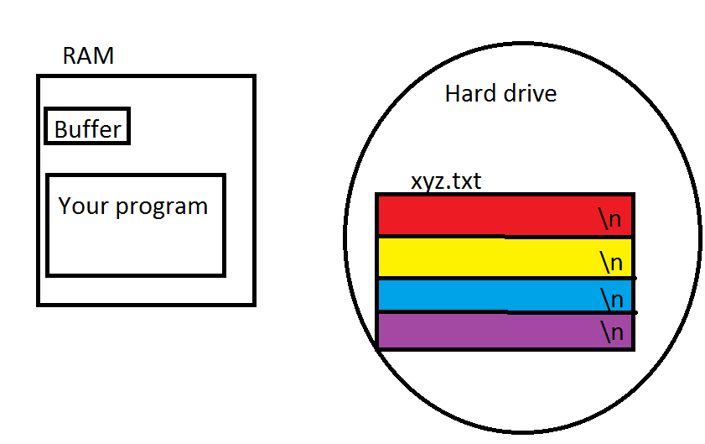
Before the open happens

Slide 9
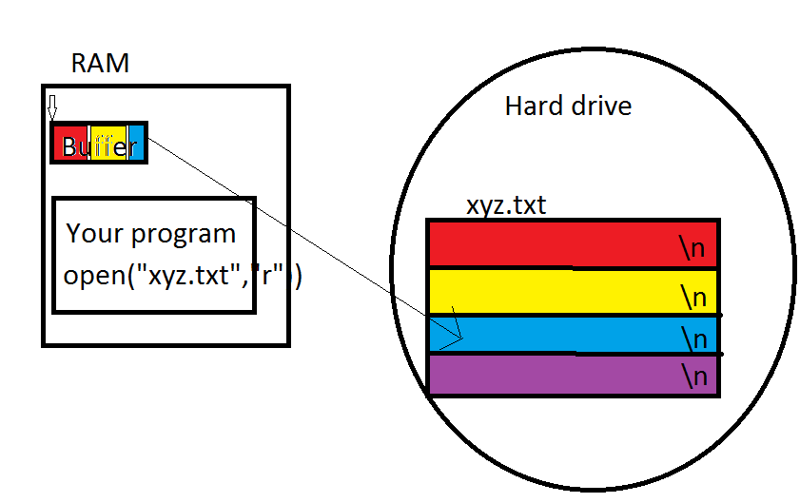
After the open

Slide 10
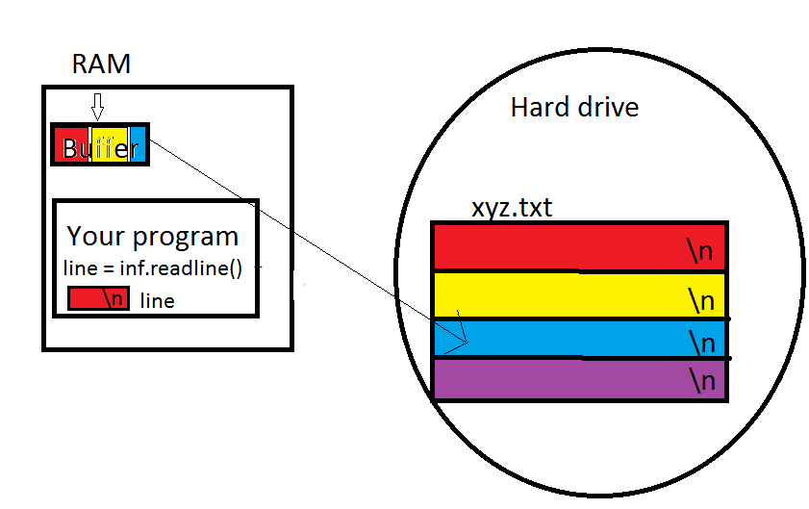
After one readline()

Slide 11
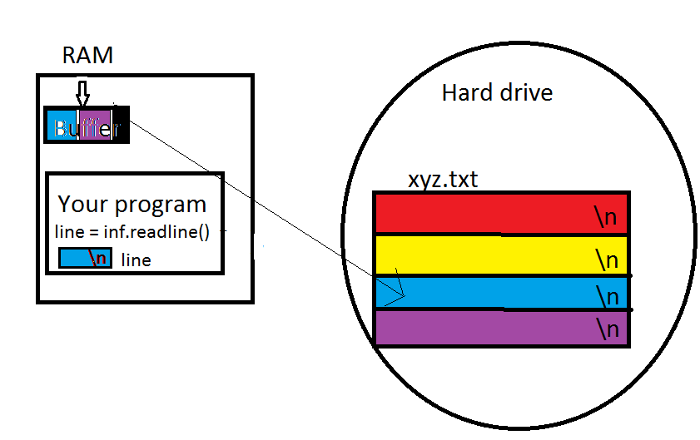
After two more readlines

Slide 12
Don’t forget!
Don’t forget to close your files!
  and the close statement must look like
  infile.close()
  No arguments in the parentheses but they must be there!

